Slide 1
Something IS better than Zero: Integrating Continual Improvement and Zero Energy Goals Presented At ACEEE Industrial Energy Efficiency Summer Study 13 August 2019
David B. Goldstein, Ph.D.
Natural Resources Defense Council
dgoldstein@nrdc.org

Slide 2
Climate Change: Melting Glaciers

Slide 3
Climate Change: Forest Fires
Notes:
Reddest sunrise in decades—produced by smoke particulates from forest fires 50 miles away. The fires are a likely result of climate change. We have also seen such fires in the Northwest, and hurricanes in Puerto Rico, the Caribbean, Florida, and Texas.

Slide 4
Introduction to Zero Net Energy (ZNE)
Zero net energy goals are an important tool for meeting globally accepted climate goals (see next slide)
This paper describes 4 levels of “zero” with increasing levels of ambition
These levels can be integrated with the continual improvement goals in ISO 50001 and “Strategic Energy Management”
Notes:
These four levels are seen in a number of program plans and ideas but are not usually presented as a consistent package.

Slide 5
U.S. Pathways to Paris’ Long-term Goals

Slide 6
“Nothing is better than zero”
Zero Net Energy has attracted rapidly growing interest around the world
Growth rates of projected and verified Zero Energy buildings are continuing to be high
Some industrial facilities claim Zero Energy performance
Zero Energy is an easily understood concept that helps make efficiency visible
Zero Energy buildings may not cost more to build than conventional practice, but they provide non-energy benefits such as comfort, health, etc.
Zero Energy industrial plants may also provide improved profitability and quality

Slide 7
But…
What do we mean by zero?
Zero Net Energy does not mean zero energy bills
After Zero Net Energy facilities--or even stand-alone solar and wind energy--become common, Zero Net Energy does not mean zero emissions from the grid
Key questions this talk will address:
What is the scope of a Zero Energy facility: how do you count energy?
How can you zero out emissions?
What if you count supply chain energy of construction of the facility?
What if you count transportation energy to service it?
How does a Zero Energy goal fit into an Energy Management System that is built around continual improvement?

Slide 8
How do we net out production and consumption?
Current definitions globally look at accumulated annual energy consumption and accumulated on-site renewable energy production
When production equals consumption this is called Zero Net Energy
But this metric has complexities that will be discussed next

Slide 9
Zero Net Energy is the same thing as 100% renewable energy, right?
Not exactly:
100% renewables can be achieved by just spending money, while ZNE requires thought and action within the facility
100% renewables might include renewable energy far removed from the plant site (such as solar in Sri Lanka for a plant in Alabama)
Are the offsite renewables additional? How do we know?
ZNE buildings almost always are extremely efficient: efficiency comes first and renewables second
Notes:
Remember that the motivation is climate, which is global. Individual accomplishment means nothing unless it is a building block to global accomplishment.

Slide 10
Renewable Energy Production: where do we draw the boundaries?
Geographically:
Temporally:
At the unit?
At the property?
At the subdivision?
At some specified distance?
What about RECs?
By the year for the first year?
Continually by the year for N years into the future?
Measured by annual average or on an hourly or 15-minute basis?

Slide 11
How do existing ZNE Standards draw these geographic boundaries?
Offsite renewables are generally discouraged if not outright disallowed
The use of Renewable Energy Credits (RECs) is usually prohibited or deeply discounted; and
RECs from onsite renewables must be retired, not sold
The issue is complex: questions include ownership of the renewables, treatment of RECs, connection of the renewables to the facility, control over the renewables, distance from the site…
Consistent standards would be helpful

Slide 12
How do existing ZNE Standards draw these temporal boundaries?
Current standards look at annual averages and consider only one year, or look at achievement of ZNE one year at a time
This paper looks at long-term plans over ten years or longer
It also recommends consideration of short-term (hourly or shorter) energy balance

Slide 13
The Electric Grid

Slide 14
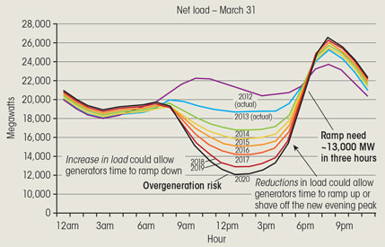
Diurnal Variation: the “Duck Curve”
Notes:
(Animated) In CA, this phenomenon is called the ‘Duck Curve’

Slide 15
This is the duck: (net electricity loads in California vs. time of day)

Slide 16
California GHG Emissions Factors 2018
* CPUC Avoided Cost Model 2018: http://www.cpuc.ca.gov/General.aspx?id=5267
Notes:
GHGs merit their own slide because they are more complicated
GHG benefits significant, but smaller than you would intuitively expect based on duck curve.
This slide different from paper, updated from 2017 to 2018 ACM => Better GHG benefits than 2017, but still not very high
To assess GHG benefits, need hourly emissions factor
Currently available hourly emissions factors (CPUC, CEC) use average, or short-run/dispatch marginal accounting methodologies
Average isn’t right way to account for policy impacts (avoided GHGs)
Short-run marginal doesn’t account for impacts of large-scale electrification policies, require building new generation
New generation will be mostly carbon free (RPS, SB 100), entirely carbon-free in solar hours. Not reflected in CPUC emissions factors
Takeaway: GHG benefits of large scale managed HPWH adoption

Slide 17
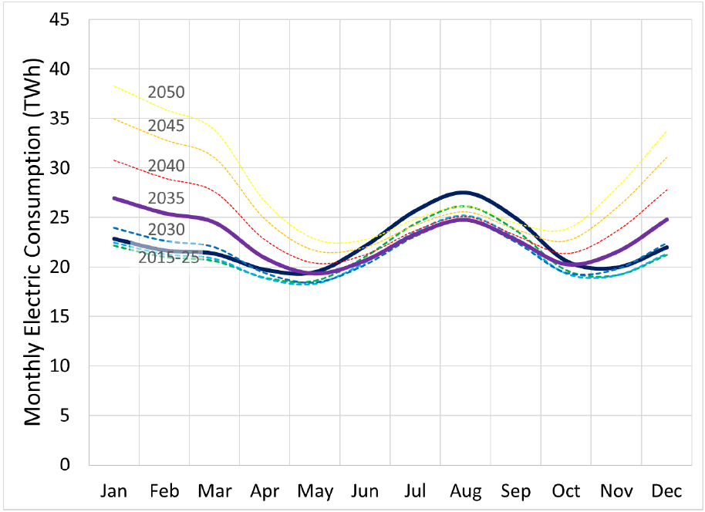
Energy efficiency remains essential to address annual variation
Potential Shift to Winter Peak Under High Electrification Scenario
NEEP: Northeastern Regional Assessment of Strategic Electrification, July 2017
https://neep.org/strategic-electrification-regional-assessment
Notes:
Northeast, not CA: explain chart: summer to winter peak, increase system peak, new power plants and poles and wires => system costs:
Direct customer costs (higher use)
Grid costs => impacts all customers through higher rates
Instead, want to fill valleys: no incremental fixed costs, higher sales, downward pressure on rates.

Slide 18
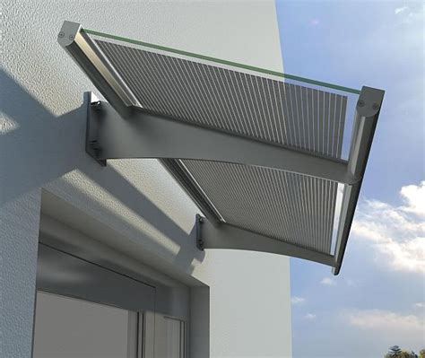
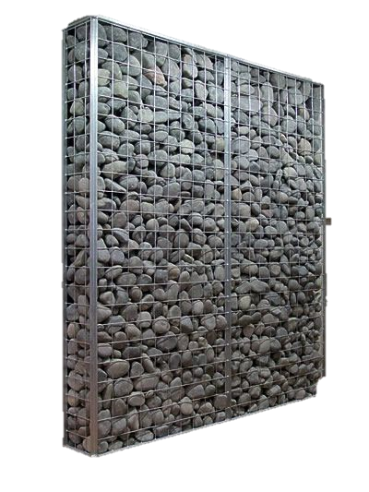
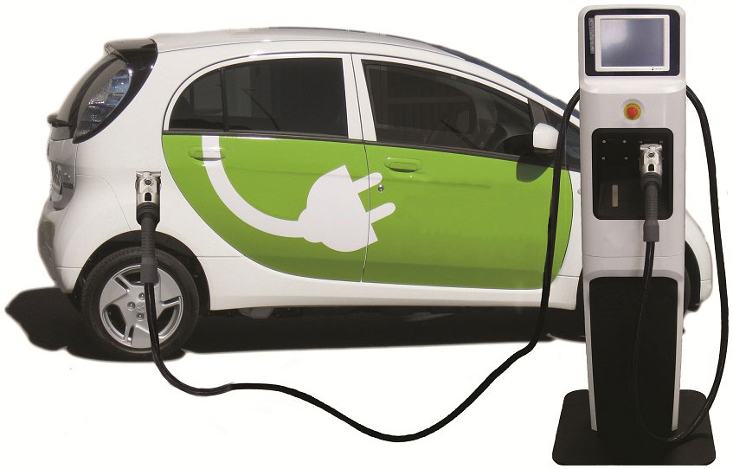
Opportunities for Consumer Integration with Grid
Permanent Efficiency
Reduce energy loads…
Peak Shifting
Design to modify time of peak energy use to adapt to grid…
Dynamic Response
Actively reduce energy use in response to short-term grid constraints…
Dispatchable Energy Storage
Actively manage energy use patterns based on grid signals…
Notes:
By deploying building/grid integration strategies, utilities can hedge against some price volatility while reducing private incentive to hedge independently of utility interests.

Slide 19
Facility Load Curve
Peak Shift
ADR
Storage
Base Load
Load Factor
Energy Efficiency
Notes:
(Animated): Building load shape can be manipultated to improve grid-interaction. This is a conceptual description of how GO will impact building load shape.

Slide 20
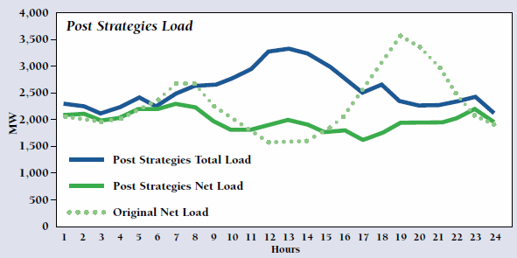
Teaching the Duck to Fly”
Notes:
Based on Jim Lazar’s analysis of how deploying demand response technologies can impact the load curve.

Slide 21
Seasonal variation

Slide 22
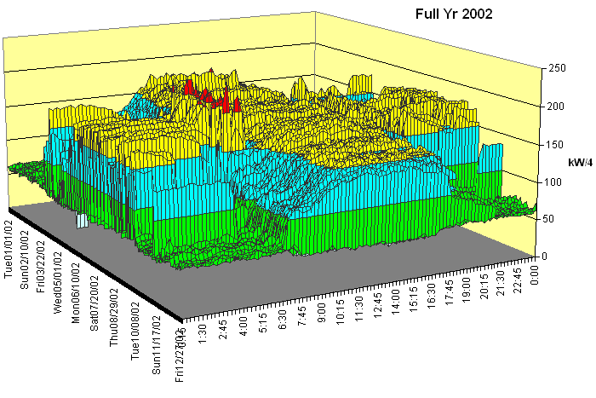
Process design evaluation should include load shape predictions so that fixed and adjustable building features can be incorporated to manage load shape.
Energy Modeling
3D Electric Profile, Full Year

Slide 23
Integrating ZNE and SEM
This paper defines four levels of ZNE and suggests continual improvement from the lowest level to higher levels:
ZNE as annual average
ZNE considering the energy inputs to the grid and a time of use basis
ZNE considering in addition the energy required to construct the facility
ZNE considering in addition transportation energy of supplies and people to the site

Slide 24
Zero Energy and Continual Improvement
Definitions of zero energy often focus on metered energy use
If energy performance (which doesn’t count renewables) is continually improving, net zero in year N means net consumption in years N-1, N-2…etc.
And it also implies net positive contribution to the grid in years N+1, N+2…
Designers can specify an energy policy for continual improvement that brings the facility to Zero Net in a planned year
Outcomes are projected using a very simplified model (see Annex 1)

Slide 25
Carbon Emissions over Time

Slide 26
Carbon Emissions over Time

Slide 27
Cumulative Carbon Emissions

Slide 28
It takes a lot more solar…

Slide 29
Transportation may not change crossover much (with lots of solar generation)

Slide 30
Conclusions
The Zero Net Energy concept is proving an attractive way of making efficiency visible and encouraging renewable energy use
Zero Net Energy will not result in zero utility bills nor in zero carbon emissions, but
Continual improvement can allow zero emissions at a projected year in the foreseeable future
Zeroing out construction energy and transportation makes the goal much more difficult and requires much greater use of renewables

Slide 31
Thank you
Please contact me at
DGoldstein@NRDC.org
for questions or comments

Slide 32
Annex 1

Slide 33
[Assumptions for model]
Zero energy building uses 40% of the energy of a conventional building
The conventional building creates about as much emissions to construct as it does to operate over 50 years
The carbon intensity of emissions avoided by solar on-site is 60% of the grid average
Energy consumption before counting solar declines at 3% (alternately 5%) annually
Transportation emissions are about half the operational emissions of the conventional building
Grid emissions intensity stays constant in the model, but energy performance improvements may include Demand Response

Slide 34
Annex 2

Slide 35
Meeting Long Term Climate Goals –California’s Experience

